Slide 1
Machine Learning Workshop: Machine Learning

Slide 2
https://towardsdatascience.com/

Slide 3
Machine learning: definition
A research field at the intersection of statistics, artificial intelligence, and computer science and is also known as predictive analytics or statistical learning. (A. Muller)
Programming computers to optimize a performance criterion using example data or past experience. (E. Alpaydin)
https://www.cmpe.boun.edu.tr/~ethem/i2ml2e/
The scientific study of algorithms and statistical models that computer systems use to perform a specific task without using explicit instructions, relying on patterns and inference instead. (Wikipedia)
Notes:
Artificial Intelligence, Pattern recognition, Data Mining, Deep Learning

Slide 4
Types of machine learning
Machine Learning
Supervised Learning
Classification
Regression
Unsupervised Learning
Reinforcement Learning
Notes:
Supervised learning labeled data/prediction, unsupervised learning unlabeled data/hidden structures in the data
Reinforcement learning used to model decision processes based on a reward system to learn series of actions
Semi-supervised learning, Recommender systems, Association analysis (data mining) etc..

Slide 5
Supervised learning
New input x
x y
Input1 Output1
Learning Algorithm
Input2 Output2
Model
Input-n Output-n
Predicted Output y
Labeled data
Notes:
Supervised learning: learning what is known already to make predictions on the outputs of new samples
Machine learning algorithms that learn from input/output pairs are called supervised learning algorithms because a “teacher” provides supervision to the algorithms in the form of the desired outputs for each example that they learn from. While creating a dataset of inputs and outputs is often a laborious manual process, supervised learning algorithms are well understood and their performance is easy to measure. If your application can be formulated as a supervised learning problem, and you are able to create a dataset that includes the desired outcome, machine learning will likely be able to solve your problem

Slide 6
Supervised learning: classification vs. regression
https://aldro61.github.io/microbiome-summer-school-2017/sections/basics/
Notes:
In classification, the goal is to predict a class label, which is a choice from a predefined list of possibilities
For regression tasks, the goal is to predict a continuous number, or a floating-point number in programming terms (or real number in mathematical terms).

Slide 7
Classification: examples
Credit scoring: differentiating between high-risk and low-risk customers from their income and savings
Detecting fraudulent activity in credit card transactions
Identifying the zip code from handwritten digits on an envelope
Determining whether a tumor is benign based on a medical image

Slide 8
Supervised learning: Uses
Prediction of unknown outputs
Use the model to predict the output for new inputs
Knowledge extraction
The model summarizes the association between the input and the output
Compression
The model is simpler than the data it explains
Outlier detection
Exceptions that are not covered by the model

Slide 9
Unsupervised learning
x
Clusters
Input1
Learning Algorithm
Input2
Input-n
No output
Learning what is expected
Clustering: grouping similar instances together

Slide 10
Unsupervised learning: Example
 Customer segmentation in CRM  Image compression: Color quantization
 Medicine: Disease subtyping

Slide 11
Representing Data
Representation of your input data that a computer can understand
Often it is helpful to think of your data as a table.
Each data point that you want to reason about (each email, each customer, each transaction) is a row, and
each property that describes that data point (say, the age of a customer or the amount or location of a transaction) is a column.
Each entity or row here is known as a sample (or data point)
The columns—the properties that describe these entities—are called features.
Notes:
For both supervised and unsupervised learning tasks, it is important to have a representation of your input data that a computer can understand.
Often it is helpful to think of your data as a table.
Each data point that you want to reason about (each email, each customer, each transaction) is a row, and
each property that describes that data point (say, the age of a customer or the amount or location of a transaction) is a column.

Slide 12
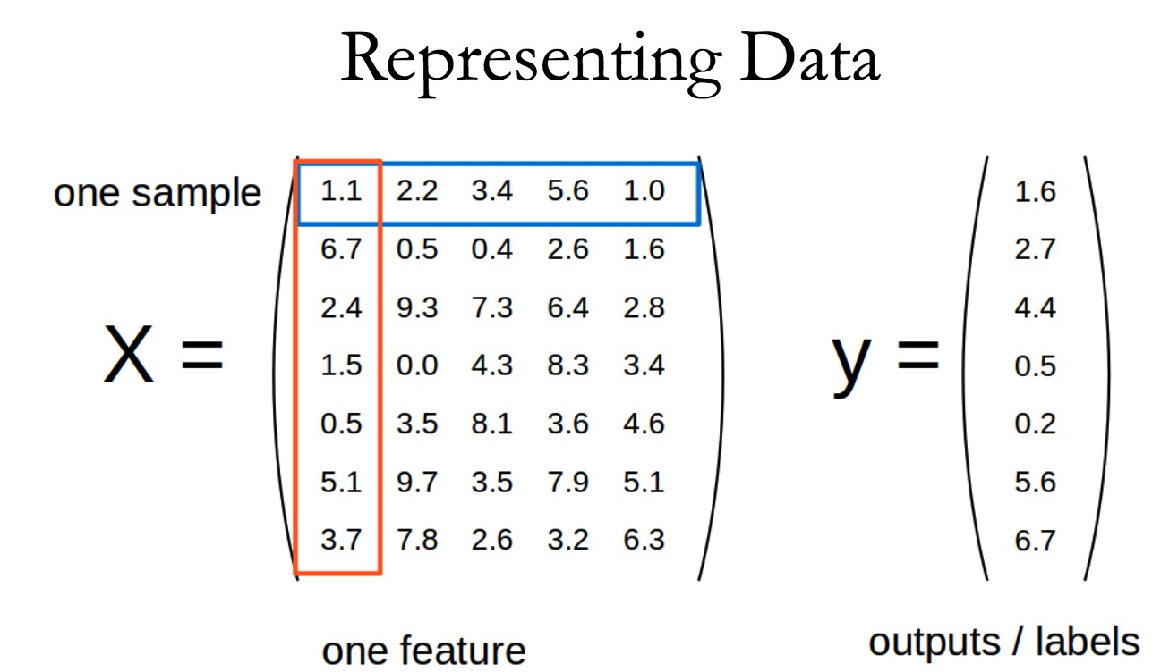
Notes:
2

Slide 13
Artificial Intelligence (AI)
Machine Learning
Reinforce-ment learning
Supervised Learning
Context extraction
Machine translation
Unsupervised Learning
Natural Language Processing
Robotics
AI
Sentiment analysis
Vision
Speech-to-text
Speech and audio
Computer vision
Image processing
Text-to-speech

Slide 14
Artificial Intelligence, Machine learning etc.
https://towardsdatascience.com/

Slide 15
K-Nearest Neighbor (kNN) Classification Algorithm

Slide 16
Theory
The intuition behind the KNN algorithm is one of the simplest of all the supervised machine learning algorithms.
It simply calculates the distance of a new data point to all other training data points.
The distance can be of any type e.g Euclidean or Manhattan etc.
It then selects the K-nearest data points, where K can be any integer.
Finally it assigns the data point to the class to which the majority of the K data points belong.

Slide 17
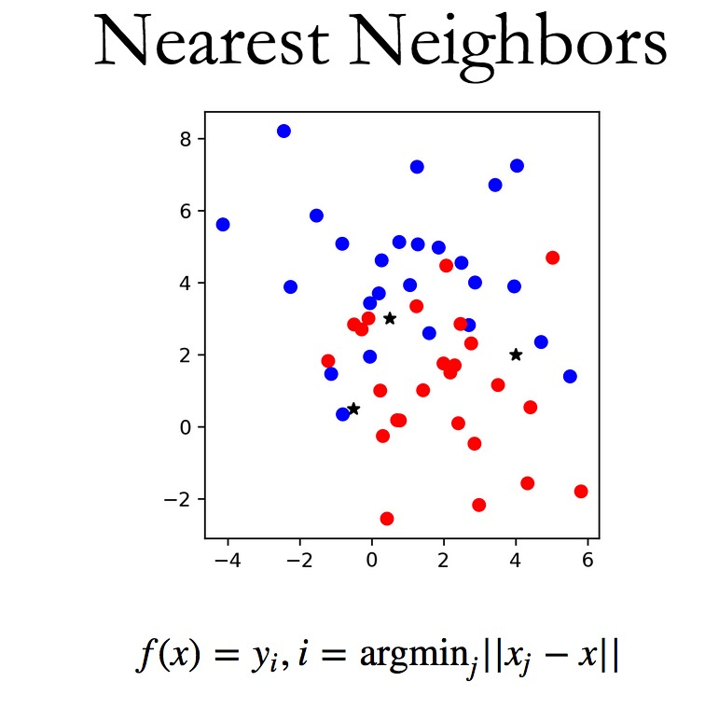

Slide 18
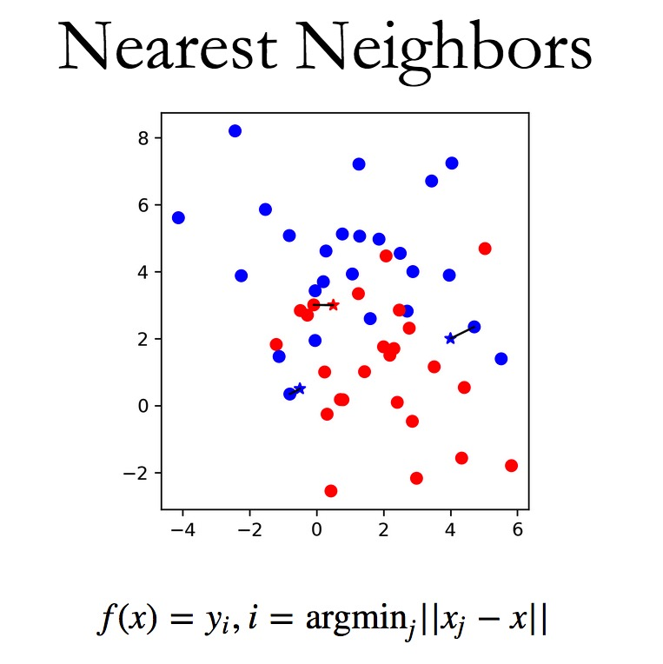

Slide 19
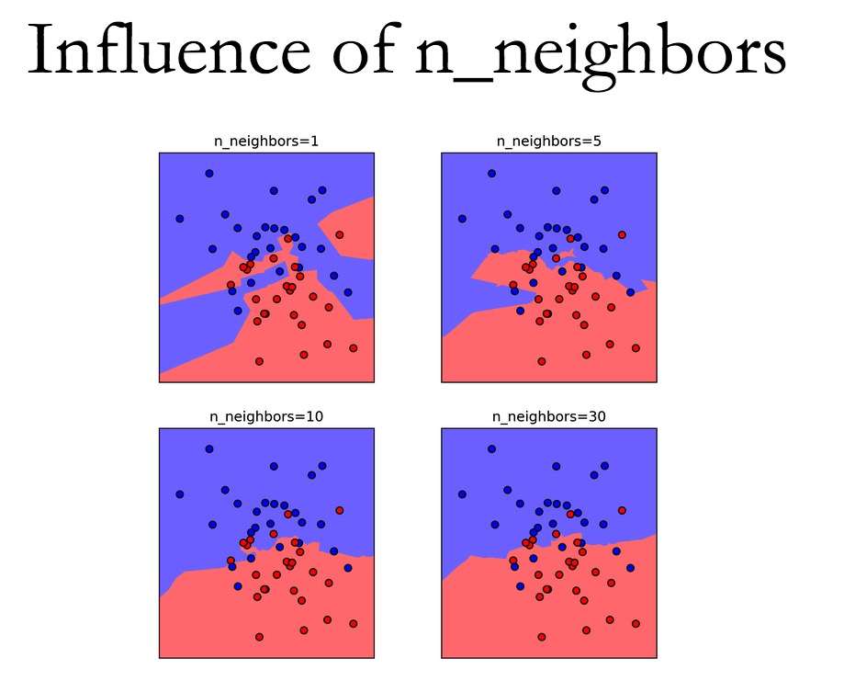

Slide 20
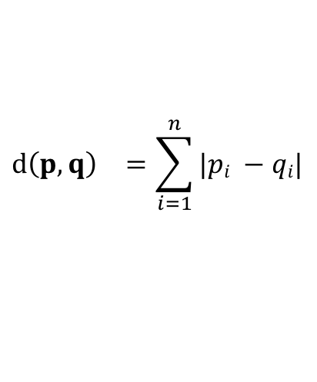
Distance metrics: (dis)similarity measure
Manhattan distance
$${d\left(p,q\right)}^{}=\sum_{i=1}^{n}{|pi −qi|}$$

Slide 21
Pros
Cons
Easy to implement
There are only two parameters required to implement KNN:
the value of K and
the distance function (e.g. Euclidean or Manhattan etc.)
Poor generalization
Prone to outliers

